Slide 1
General Services Administration
Open Government Secretariat & Open Government Roundtable
Civil Society Meeting
February 5, 2024

Slide 2

General Announcement
This event will be open to the public, and is being recorded. A copy of who attended the event (both in person and virtually), the agenda, notes taken from the event, and the recording of the event will all be posted publicly to the open.usa.gsa website.
Image Credit https://www.privacypolicies.com/blog/meeting-recording-disclaimers

Slide 3
Agenda
Greetings, Introductions, and Purpose
Ice Breaker - Three Words
News from GSA
Improving the Co-Creation Process - Miro Board Activity
BREAK
ReCap - Improving the Co-Creation Process - Read Out & Discussion
How to Engage the Public Now - Miro Board Activity
Closing Remarks & Announcements

Slide 4
Greetings, Introductions, and Purpose

Slide 5



Greetings, Introductions, and Purpose

Slide 6



US Government Roles
WHITE HOUSE OFFICE OF
SCIENCE AND TECHNOLOGY POLICY
Policy Leadership
DEPARTMENT OF STATE
&
USAID
International Implementation Management
GENERAL SERVICES ADMINISTRATION
Domestic Implementation Management

Slide 7
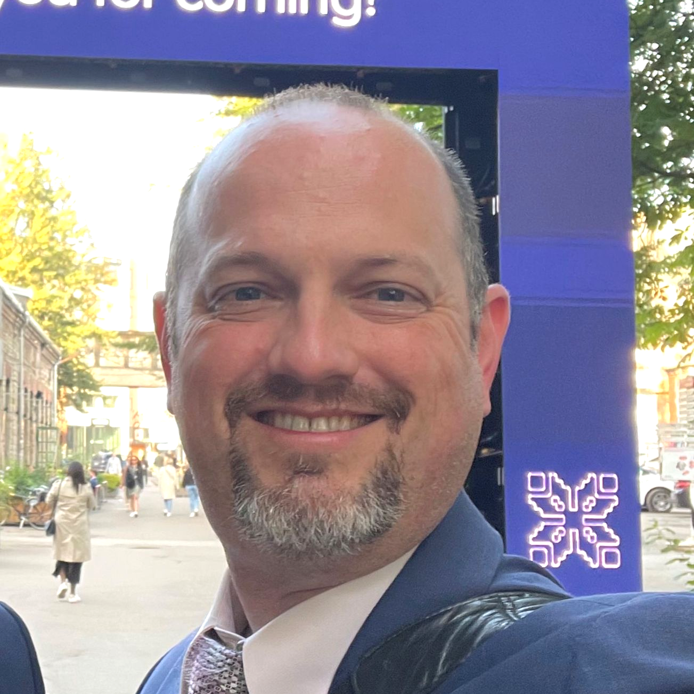
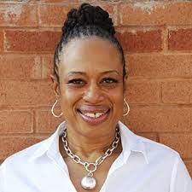




Meet the GSA Open Government Secretariat Team
DANIEL YORK
YVETTE GIBSON
ALEXIS MASTERSON
Director,
Inter-Govt Coordination / NAP 5
MEET
THE GSA
TEAM
NAP 6
LAURA SZAKMARY
ARTHUR BRUNSON
AVIS RYAN
MSF / Community Engagement
FACA / Website

Slide 8
What We Do
The GSA Open Government Secretariat serves three primary roles:
Nation Action Plan (NAP) 5 Implementation: Coordinate with federal partners to track and report progress on NAP commitments.
Nation Action Plan (NAP) 6 Development: In coordination with White House OSTP, Department of State, and USAID, co-create the 6th US Open Government NAP with Civil Society Organizations through an open and transparent process and which advances the ideals of a more inclusive, responsive, and accountable Government.
Stakeholder Engagement: Coordinate with federal government and public stakeholders groups:
Federal Stakeholder Engagement
Public Stakeholder Engagement
Host & Maintain an Open Government public website
1
2
3

Slide 9

Why We are Here
Listening, Learning, Collaborating, Trust Building
Image credit: https://www.deeprootcenter.org/blog/collaboration-listening-learning

Slide 10

A Message from GSA Legal
Navigating the Public Input Process
“The purpose of this engagement session is to encourage broad public input. However, GSA does not intend to use any individual or collective opinion expressed in this forum as a guideline in the formulation of any agency policy or regulation."
Image Credit https://thebluediamondgallery.com/legal08/f/federal-law.html

Slide 11
Ice Breaker

Slide 12

Three Words Ice Breaker
Lightning Round Introductions!
We will go around the room, in a lightning round, and ask you to provide the following information:
Name
Organization
3 words to describe yourself or what you're passionate about
Virtual attendees: Please input the above information into the chat
Image Credit https://www.shutterstock.com/image-vector/atlantic-antarctic-floes-glaciers-icebergs-floating-2087872366

Slide 13
News From GSA

Slide 14
What Makes for a Successful Multi-Stakeholder Forum (MSF)?
Diverse Stakeholders
01
02
Transparency
04
Co-Creation
Components of a Successful MSF
Collaboration & Dialogue
03
06
Accountability
Consultation and Feedback
05
07
Commitments and Action Plans
Inclusivity and Equity
08
09
Adaptability
National Ownership
10
11
Peer Learning and Exchange
Notes:
The key components of a multi-stakeholder forum, according to the Open Government Partnership (OGP) and other sources, typically include: We need to establish a robust Multi-Stakeholder Forum (MSF) bringing together civil society, federal agencies, academia, and industry especially to craft NAP 6. The establishment of a MSF is just a collaborative space where diverse perspectives converge to shape and enhance open government practices, ensuring responsiveness to the evolving needs of society. The collaboration of various stakeholders is essential to harness collective intelligence, foster innovation, and navigate the intricate landscape of open government.
1. **Diverse Stakeholders**: Multi-stakeholder forums are inclusive and involve a wide range of participants, including government officials, civil society organizations, businesses, academia, and citizens. The diversity of participants ensures a broad perspective and expertise.
2. **Transparency**: Transparency is a fundamental principle. Discussions, decisions, and actions taken within the forum should be open and accessible to the public. This transparency builds trust and accountability.
3. **Collaboration and Dialogue**: The forum serves as a platform for open and constructive dialogue between different stakeholders. Collaborative decision-making is key to finding common ground and achieving meaningful outcomes.
4. **Co-creation**: Participants work together to create and implement policies, initiatives, or reforms. This collaborative approach allows for shared ownership of outcomes.
5. **Consultation and Feedback**: The forum should regularly seek input and feedback from stakeholders, ensuring that their perspectives and concerns are taken into account during the policy-making process.
6. **Accountability**: Mechanisms for tracking progress and holding stakeholders accountable for their commitments are essential. These mechanisms can include reporting, evaluations, and independent reviews.
7. **Commitments and Action Plans**: Multi-stakeholder forums often result in the development of action plans with specific commitments. These commitments outline the steps each stakeholder will take to advance open government goals.
8. **Inclusivity and Equity**: Ensuring that traditionally marginalized groups and communities are included is crucial. Efforts should be made to address disparities and promote equity in policy development and implementation.
9. **Adaptability**: The forum should be adaptable to changing circumstances and emerging challenges. Flexibility allows it to remain relevant and effective over time.
10. **National Ownership**: The forum should reflect the specific needs and priorities of the country it serves. It should be a nationally driven process with local ownership.
11. **Peer Learning and Exchange**: Multi-stakeholder forums can benefit from sharing experiences and best practices with other countries or regions facing similar challenges. Peer learning enhances the effectiveness of open government initiatives.
These components are essential for the success of multi-stakeholder forums, as they foster collaboration, transparency, and the development of policies and practices that promote open government and civic participation. It's important to note that the specific structure and functioning of such forums can vary from one country to another based on their unique context and needs.

Slide 15
Multi-Stakeholder Forum (MSF) Investigation
We are currently working through an ‘Investigate’ phase where we identify and gather information on various MSF Structures / Processes.
1
2
3
4
Phases of an MSF Lifecycle
Operations Management
Participant Recruitment & Creation
Formation & Iteration
Investigate

Slide 16
MSF Alternatives Analysis
The team developed a high level Alternatives Analysis and Decision Paper for GSA leadership to consider.
This analysis weighs the following possible options to reinvigorate the U.S. Multi-Stakeholder Forum within the U.S. legal and regulatory framework:
Federal Advisory Committee Act (FACA)
National Academy of Public Administration (NAPA)
Has FACA Exemption
Organized by a Public University
Civil Society Self-Organizes

Slide 17
Dedicated ListServs
Streamlining Communication
The Open Government Secretariat has decided to streamline our communication platforms, transitioning from multiple communication platforms down to two dedicated listservs:
Communication Within Government
Only available to .gov and .mil email address
Communications Outside Government (More info on how to join is coming soon)
Open to the public, anyone can join

Slide 18

Federal Agency Open Government Community of Practice
The Open Government Secretariat is reinstituting the Federal Agency Open Government Community of Practice, which met for the first time in quite a while last Tue Jan 30, 2024. It is only open to all federal agencies and personnel with a .mil or .gov email address, and plans to meet every other month with the goal of sharing knowledge, capacity building, and enhancing collaboration.
Image Credit https://iap2usa.org/event-2410826

Slide 19
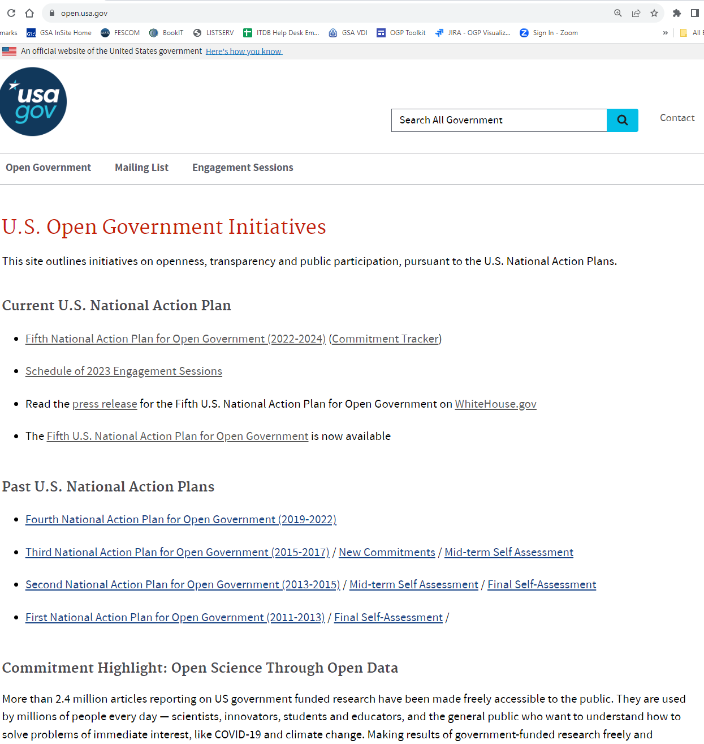
Open.usa.gov Migration
We’re combining our expertise in human-centered design and customer experience to migrate the Open.USA.gov site to the GSA.gov platform to make the website easier to use and ensure it is a source of timely, effective and accurate communication on U.S Open Government Initiatives.
Notes:
The current site will continue to be updated until the new site is launched

Slide 20
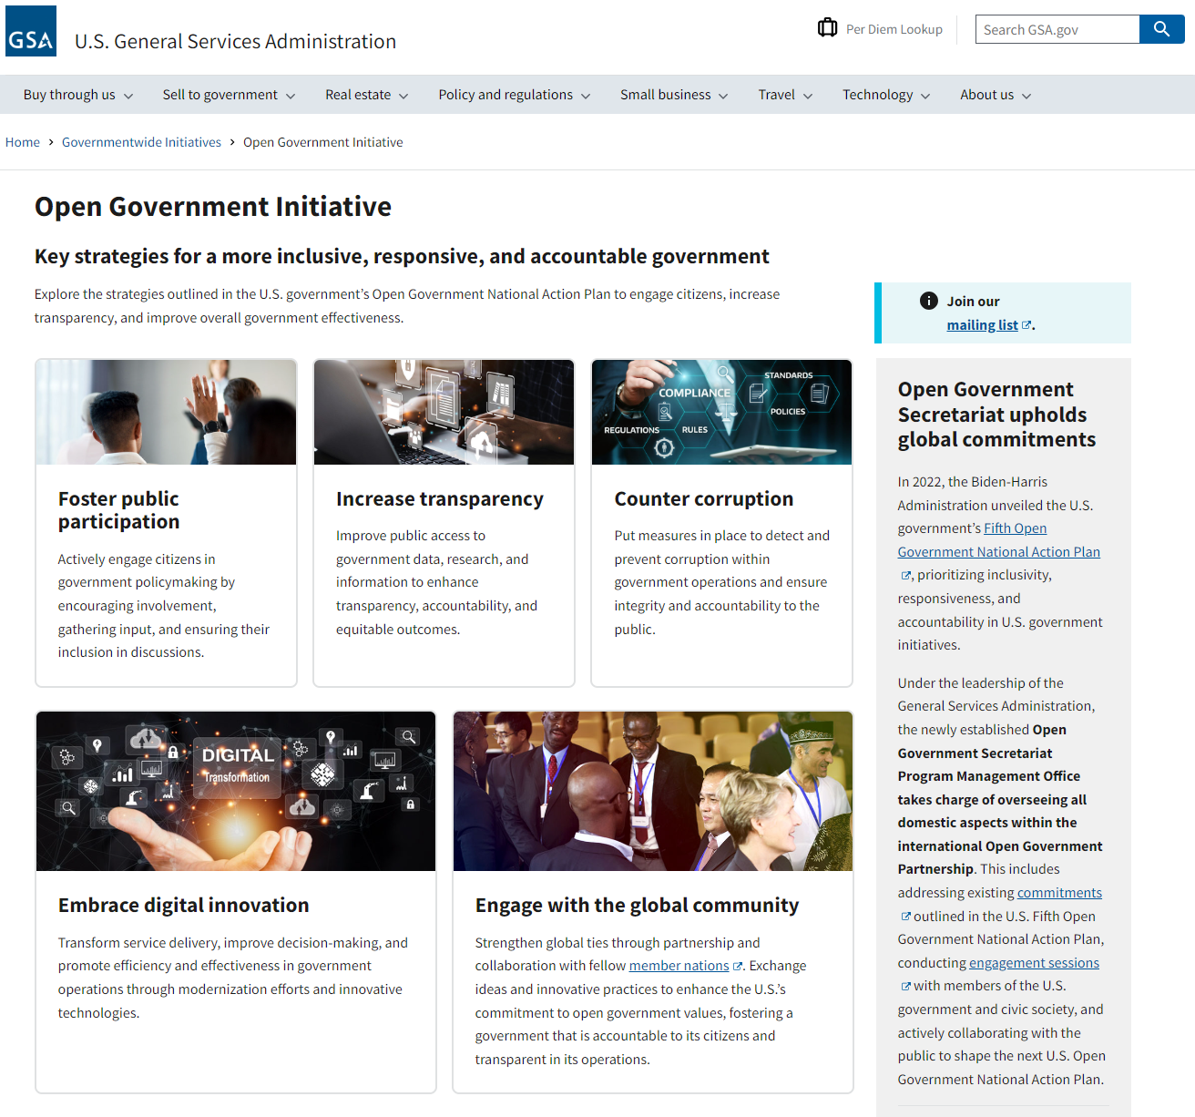
Sneak Peak
To-Be Open Government Website
The first version of the new Open Government Secretariat page is easier to use, and will include current Open Government resources, links to past U.S. NAPs, a reimagined commitment tracker displays, and much more!
https://www.gsa.gov/governmentwide-initiatives/open-government-initiative

Slide 21
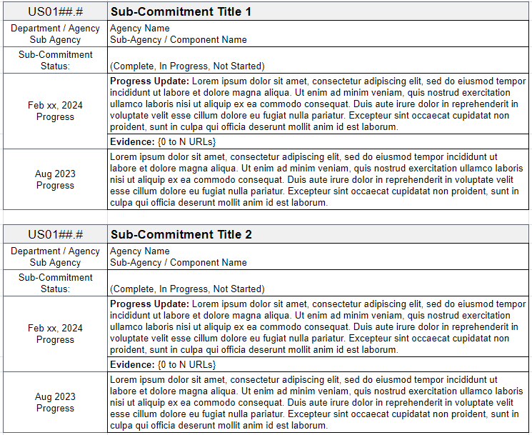

NAP 5 Commitment Tracker
Meeting the Community’s Needs
The Open Government Secretariat is in the process of collecting and posting updates to the 56 ‘in progress’ NAP 5 Commitments / Sub-Commitments, on the legacy open.usa.gov website. This update will include ‘stacked’ updates and additional information.

Slide 22
NAP 5 Commitment Overview
By the Numbers as of the Aug 2023 Update
Number of Commitments
spanning 70 sub-commitments
36
5
Number of Themes
into which commitments are divided
Number of Agencies or Components
leading a sub-commitment
25
Percentage of Fully Completed Sub-Commitments as of halfway through NAP 5’s implementation
20%
Number of Completed or On-Track Commitments as of halfway through NAP 5’s implementation
30
Notes:
5 themes are (short versions):
Improve Access to Data
Increase Civic Space
Transform Gov’t Service Delivery
Counter Corruption
Ensure Equal Justice
Current list of agency leads: https://docs.google.com/spreadsheets/d/1pSGFO7DVVdWv2BhgAWqXU8HvNd2TWjMLSzOOqfCEX3k/edit?usp=sharing
Completed Sub-Commitments is 14 out of 70 = 20%

Slide 23
NAP 6 Tentative Timeline
OCTOBER 2023 - MARCH 2024
APRIL -
SEPTEMBER 2024
OCTOBER 2024 -
MARCH 2025
APRIL-
SEPTEMBER 2025
OCTOBER - DECEMBER 2025
PHASE 1
Launch & Planning
PHASE 2
Idea Generation
PHASE 3
Drafting
PHASE 4
Publication
PHASE 5
Closeout
Strategy Development
Outreach and Idea Generation
Drafting & Reviews
Final Draft
Compile Feedback & Lessons Learned
Stakeholder Identification
Identification of Common Themes & Priorities
Refine Commitments & Incorporate Feedback
Promotional Communications
Notes:
The durations of each individual phase might shift, but it all has to be done by December 2025.
We are in the Launch & Planning stage right now.
Note: actual co-creation will take place in a Multi-Stakeholder Forum (FACA), though ideas and gov-only discussion can happen here in the CoP.

Slide 24

Summit for Democracy
Democratic Renewal in Action
The Republic of Korea will lead the third Summit for Democracy in March 2024 under the theme, “Democracy for Future Generations.” It will feature a three-day program of events in Seoul with representatives from governments and authorities, civil society, private sector, and other stakeholders.

Slide 25
Discussion

Slide 26
Improving the Co-Creation Process - Miro Exercise

Slide 27
Past Co-creation Approaches
Exploring Past Processes
Open government in the 2008 transition
2009 Open Government Directive and plans
Online ideation platforms
OpenGov@ email and roundtables
White boards and posters for in-person workshops
Github and in-person workshops
Virtual forums, forms, and documents

Slide 28
Miro Board Instructions
Live Demonstration
First, please navigate to the following link to access the Miro Board: https://miro.com/app/board/uXjVNytHJak=/?share_link_id=470719355651
Second, we will conduct a live instructional demonstration on using the tool

Slide 29
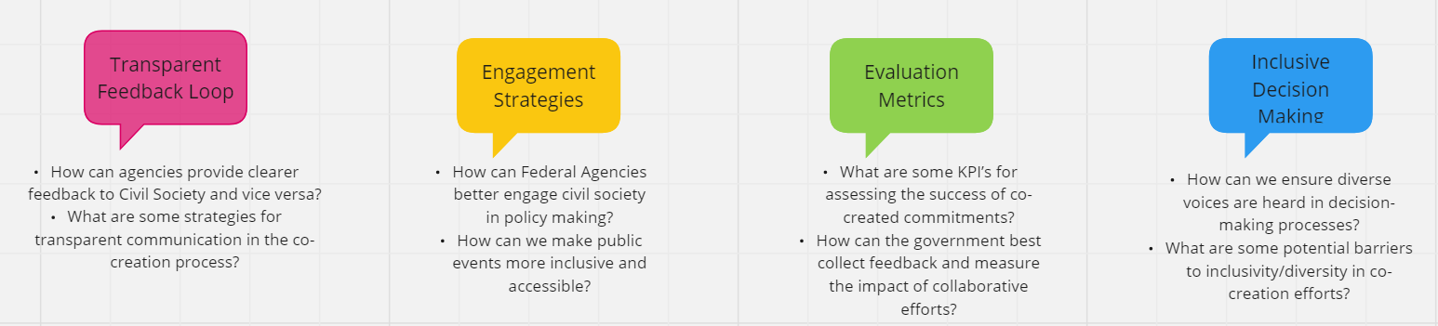
Miro Board Activity
Improving the co-creation process with civil society
Using the same Miro Board link from our ice breaker navigate to the second activity section.
Assign one person from your table (or breakout room) to be the scribe.

Slide 30
Break - 10 Minutes

Slide 31
Co-Creation Activity Recap

Slide 32

Opportunities for Immediate Engagement
How Can GSA’s Open Government Secretariat Help?
At your table, or in your breakout room, using the Miro board found here, please add sticky notes to the Activity 3 area around the following topics:
Are there any events coming up GSA’s Secretariat should know about or participate in?
What type of standard or regular meetings would be helpful for civil society?
Image Credit https://commons.wikimedia.org/wiki/File:Sticky_Notes_in_different_colors.jpg

Slide 33
Closing Remarks & Announcements

Slide 34
Closing Remarks

Slide 35
Partner with Us!
Planning for the Next Event
A large thank you to the Open Government Roundtable for their part in planning and facilitating this meeting!
Do you have ideas for future events? Are you interested in helping with the next one? Let us know at OpenGovernmentSecretariat@gsa.gov
Open.usa.gov

Slide 36
Thank You!
Contact Us: OpenGovernmentSecretariat@gsa.gov

